Slide 1
FILE HANDLING IN C
EPROG
COMPUTER FUNDAMENTALS & PROGRAMMING FOR ENGINEERING STUDENTS
<<professor>>

Slide 2
File handling in C
In C we use FILE * to represent a pointer to a file.
fopen is used to open a file. It returns the special value NULL to indicate that it couldn't open the file.
FILE *fptr;
char filename[]= "file2.dat";
fptr= fopen (filename,"w");
if (fptr == NULL) {
fprintf (stderr, “ERROR”);
/* DO SOMETHING */
}

Slide 3
Modes for opening files
The second argument of fopen is the mode in which we open the file. There are three
"r" opens a file for reading
"w" opens a file for writing - and writes over all previous contents (deletes the file so be careful!)
"a" opens a file for appending - writing on the end of the file

Slide 4
The exit() function
Sometimes error checking means we want an "emergency exit" from a program. We want it to stop dead.
In main we can use "return" to stop.
In functions we can use exit to do this.
Exit is part of the stdlib.h library
exit(-1);
in a function is exactly the same as
return -1;
in the main routine

Slide 5
Writing to a file using fprintf
fprintf works just like printf and sprintf except that its first argument is a file pointer.
We could also read numbers from a file using fscanf – but there is a better way.
FILE *fptr;
fptr= fopen ("file.dat","w");
/* Check it's open */
fprintf (fptr,"Hello World!\n");

Slide 6
Reading from a file using fgets
fgets is a better way to read from a file
We can read into a string using fgets
FILE *fptr;
char line [1000];
/* Open file and check it is open */
while (fgets(line,1000,fptr) != NULL) {
printf ("Read line %s\n",line);
}
fgets takes 3 arguments, a string, a maximum
number of characters to read and a file pointer.
It returns NULL if there is an error (such as EOF)

Slide 7
Closing a file
We can close a file simply using fclose and the file pointer. Here's a complete "hello files".
FILE *fptr;
char filename[]= "myfile.dat";
fptr= fopen (filename,"w");
if (fptr == NULL) {
printf ("Cannot open file to write!\n");
exit(-1);
}
fprintf (fptr,"Hello World of filing!\n");
fclose (fptr);

Slide 8
Great Muck-Ups in C #72 of 100
We use the file pointer to close the file - not the name of the file
FILE *fptr;
fptr= fopen ("myfile.dat","r");
/* Read from file */
fclose ("myfile.dat");
/* Ooops - that's wrong */

Slide 9
Three special streams
Three special file streams are defined in the stdio.h header
stdin reads input from the keyboard
stdout send output to the screen
stderr prints errors to an error device (usually also the screen)
What might this do:
fprintf (stdout,"Hello World!\n");

Slide 10
Reading loops
It is quite common to want to read every line in a program. The best way to do this is a while loop using fgets.
/* define MAXLEN at start using enum */
FILE *fptr;
char tline[MAXLEN]; /* A line of text */
fptr= fopen ("sillyfile.txt","r");
/* check it's open */
while (fgets (tline, MAXLEN, fptr) != NULL) {
printf ("%s",tline); // Print it
}
fclose (fptr);

Slide 11
Using fgets to read from the keyboard
fgets and stdin can be combined to get a safe way to get a line of input from the user
#include <stdio.h>
int main()
{
const int MAXLEN=1000;
char readline[MAXLEN];
fgets (readline,MAXLEN,stdin);
printf ("You typed %s",readline);
return 0;
}

Slide 12
Getting numbers from strings
Once we've got a string with a number in it (either from a file or from the user typing) we can use atoi or atof to convert it to a number
The functions are part of stdlib.h
char numberstring[]= "3.14";
int i;
double pi;
pi= atof (numberstring);
i= atoi ("12");
Both of these functions return 0 if they have a problem

Slide 13
Great Muck-Ups in C #11 of 100
fgets includes the '\n' on the end
This can be a problem - for example if in the last example we got input from the user and tried to use it to write a file:
FILE *fptr;
char readfname[1000];
fgets (readfname,1000,stdin);
fptr= fopen (readfname,"w");
/* oopsie - file name also has \n */
Even experienced programmers can make
this error

Slide 14
What is a File?
A file is a collection of related data that a computers treats as a single unit.
Computers store files to secondary storage so that the contents of files remain intact when a computer shuts down.
When a computer reads a file, it copies the file from the storage device to memory; when it writes to a file, it transfers data from memory to the storage device.
C uses a structure called FILE (defined in stdio.h) to store the attributes of a file.

Slide 15
Steps in Processing a File
Create the stream via a pointer variable using the FILE structure: FILE *p;
Open the file, associating the stream name with the file name.
Read or write the data.
Close the file.

Slide 16
The basic file operations are
fopen - open a file- specify how its opened (read/write) and type (binary/text)
fclose - close an opened file
fread - read from a file
fwrite - write to a file
fseek/fsetpos - move a file pointer to somewhere in a file.
ftell/fgetpos - tell you where the file pointer is located.

Slide 17
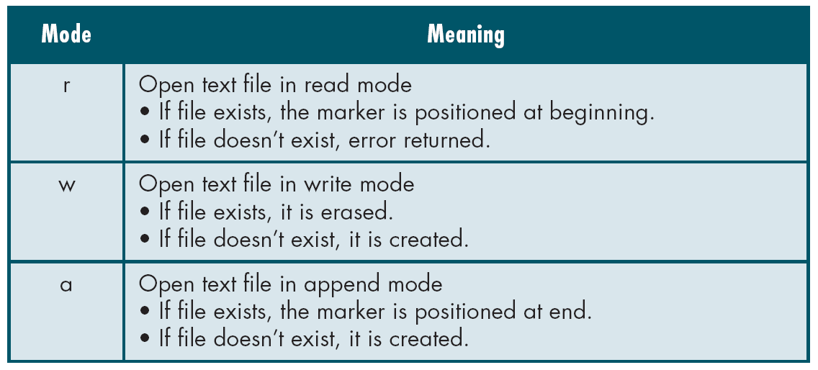
File Open Modes
from Table 7-1 in Forouzan & Gilberg, p. 400

Slide 18
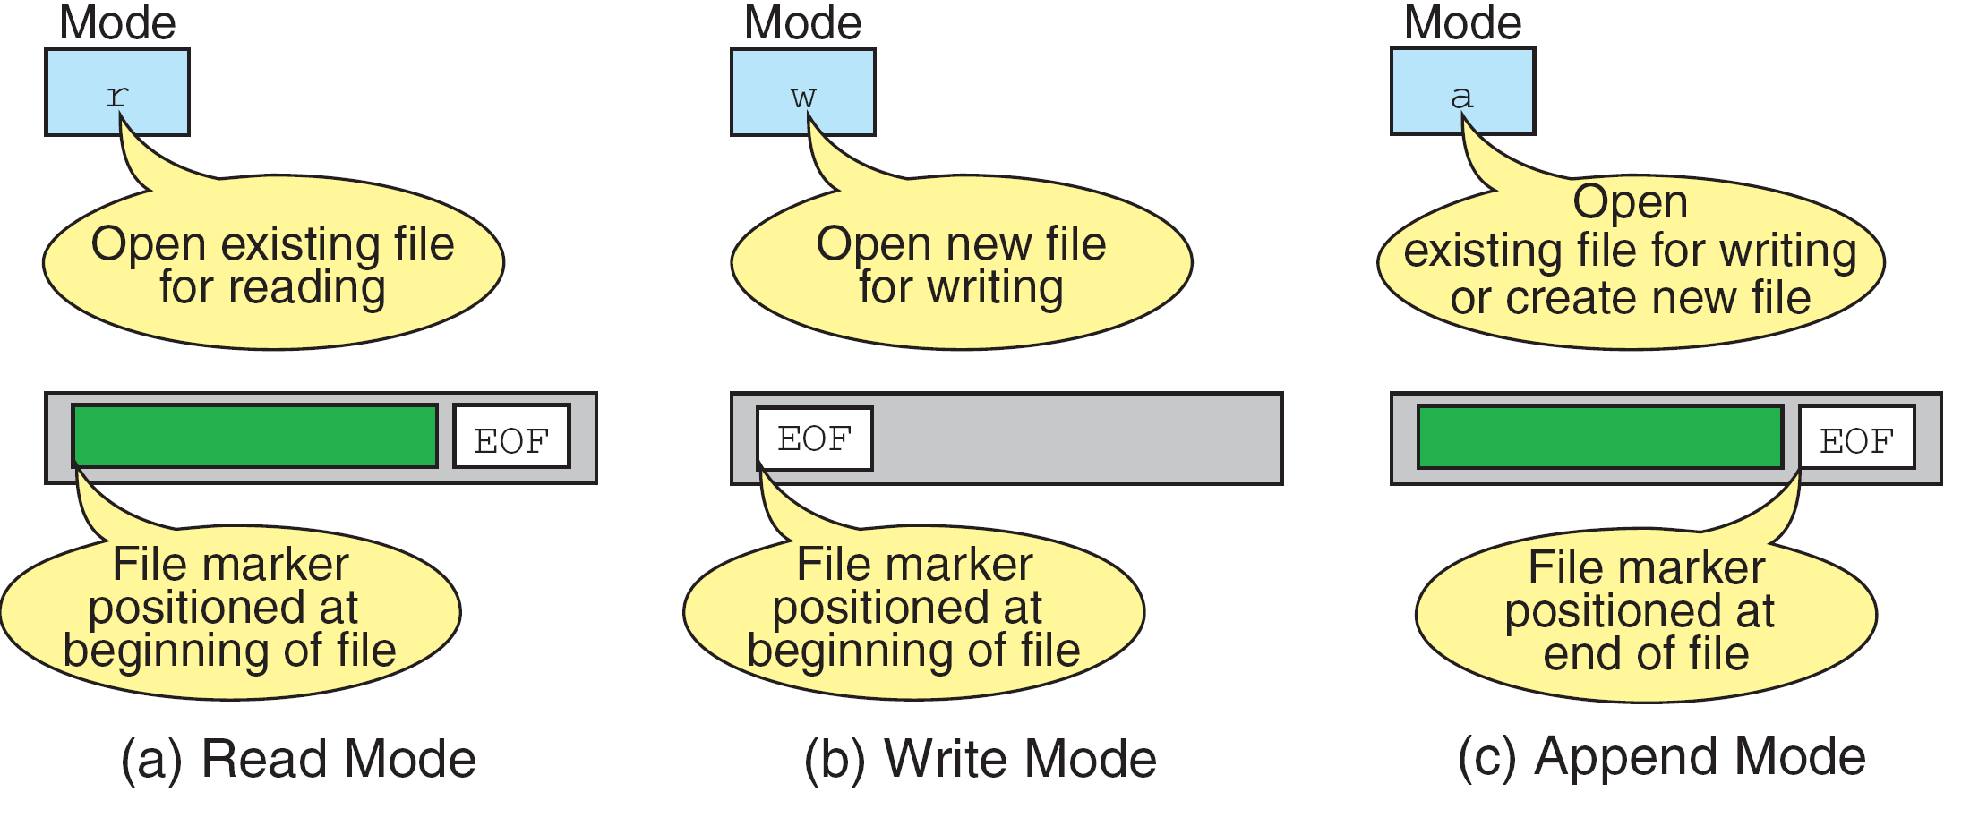
More on File Open Modes
from Figure 7-4 in Forouzan & Gilberg, p. 401

Slide 19
Additionally,
r+ - open for reading and writing, start at beginning
w+ - open for reading and writing (overwrite file)
a+ - open for reading and writing (append if file exists)

Slide 20
File Open
The file open function (fopen) serves two purposes:
It makes the connection between the physical file and the stream.
It creates “a program file structure to store the information” C needs to process the file.
Syntax: filepointer=fopen(“filename”, “mode”);

Slide 21
More On fopen
The file mode tells C how the program will use the file.
The filename indicates the system name and location for the file.
We assign the return value of fopen to our pointer variable:
spData = fopen(“MYFILE.TXT”, “w”);
spData = fopen(“A:\\MYFILE.TXT”, “w”);

Slide 22
More On fopen
from Figure 7-3 in Forouzan & Gilberg, p. 399

Slide 23
Closing a File
When we finish with a mode, we need to close the file before ending the program or beginning another mode with that same file.
To close a file, we use fclose and the pointer variable: fclose(spData);

Slide 24
fprintf()
Syntax:
fprintf (fp,"string",variables);
Example:
int i = 12;
float x = 2.356;
char ch = 's';
FILE *fp;
fp=fopen(“out.txt”,”w”);
fprintf (fp, "%d %f %c", i, x, ch);

Slide 25
fscanf()
Syntax:
fscanf (fp,"string",identifiers);
Example:
FILE *fp;
Fp=fopen(“input.txt”,”r”);
int i;
fscanf (fp,“%d",i);

Slide 26
getc()
Syntax:
identifier = getc (file pointer);
Example:
FILE *fp;
fp=fopen(“input.txt”,”r”);
char ch;
ch = getc (fp);

Slide 27
putc()
write a single character to the output file, pointed to by fp.
Example:
FILE *fp;
char ch;
putc (ch,fp);

Slide 28
End of File
There are a number of ways to test for the end-of-file condition. Another way is to use the value returned by the fscanf function:
FILE *fptr1;
int istatus ;
istatus = fscanf (fptr1, "%d", &var) ;
if ( istatus == feof(fptr1) )
{
printf ("End-of-file encountered.\n”) ;
}

Slide 29
Reading and Writing Files
#include <stdio.h>
int main ( )
{
FILE *outfile, *infile ;
int b = 5, f ;
float a = 13.72, c = 6.68, e, g ;
outfile = fopen ("testdata", "w") ;
fprintf (outfile, “ %f %d %f ", a, b, c) ;
fclose (outfile) ;
infile = fopen ("testdata", "r") ;
fscanf (infile,"%f %d %f", &e, &f, &g) ;
printf (“ %f %d %f \n ", a, b, c) ;
printf (“ %f %d %f \n ", e, f, g) ;
}

Slide 30
Example
#include <stdio.h>
#include<conio.h>
void main()
{
char ch;
FILE *fp;
fp=fopen("out.txt","r");
while(!feof(fp))
{
ch=getc(fp);
printf("\n%c",ch);
}
getch();
}

Slide 31
fread ()
Declaration:
size_t fread(void *ptr, size_t size, size_t n, FILE *stream);
Remarks:
fread reads a specified number of equal-sized
data items from an input stream into a block.
ptr = Points to a block into which data is read
size = Length of each item read, in bytes
n = Number of items read
stream = file pointer

Slide 32
Example
Example:
#include <stdio.h>
int main()
{
FILE *f;
char buffer[11];
if (f = fopen("fred.txt", “r”))
{
fread(buffer, 1, 10, f);
buffer[10] = 0;
fclose(f);
printf("first 10 characters of the file:\n%s\n", buffer);
}
return 0;
}

Slide 33
fwrite()
Declaration:
size_t fwrite(const void *ptr, size_t size, size_t n, FILE*stream);
Remarks:
fwrite appends a specified number of equal-sized data items to an output file.
ptr = Pointer to any object; the data written begins at ptr
size = Length of each item of data
n =Number of data items to be appended
stream = file pointer

Slide 34
Example
Example:
#include <stdio.h>
int main()
{
char a[10]={'1','2','3','4','5','6','7','8','9','a'};
FILE *fs;
fs=fopen("Project.txt","w");
fwrite(a,1,10,fs);
fclose(fs);
return 0;
}

Slide 35
fseek()
This function sets the file position indicator for the stream pointed to by stream or you can say it seeks a specified place within a file and modify it.
SEEK_SET Seeks from beginning of file
SEEK_CUR Seeks from current position
SEEK_END Seeks from end of file
Example:
#include <stdio.h>
int main()
{ FILE * f; f = fopen("myfile.txt", "w"); fputs("Hello World", f); fseek(f, 6, SEEK_SET); SEEK_CUR, SEEK_END fputs(" India", f); fclose(f); return 0; }

Slide 36
ftell()
offset = ftell( file pointer );
"ftell" returns the current position for input or output on the file
#include <stdio.h>
int main(void)
{
FILE *stream;
stream = fopen("MYFILE.TXT", "w");
fprintf(stream, "This is a test");
printf("The file pointer is at byte %ld\n", ftell(stream));
fclose(stream);
return 0;
}

